Slide 1
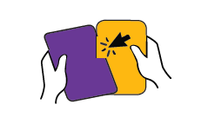
환영합니다!
다음과 같이 하시기를 바랍니다:
조성
&
놀이
…여러분의 Pre-k 가정 공동체를 더욱 알아가십시오!
Notes:
*Note: This Power Point is for an event with Families and children present. You can find more support in your Pre-K Teacher, Leader and Staff Handbook.
Welcome/Ice-breaker (5-10 mins)
Greet families warmly.
*Have a plan to welcome latecomers and transition them smoothly into the current activity.
Invite families to build with the Fun with Feelings cards however they choose. Demonstrate how to line up the slits to fit the cards together. You might also have an example structure set up to demonstrate.
• Encourage families to play and talk with each other.
Reinforce children’s creativity, effort, and social-emotional skills (e.g., sharing, taking turns) using positive narration or specific praise. Consider using the examples from the Fun with Feelings Handbook.
For example, you could say:
“Wow you’re flying the card like an airplane! That’s a great use of your imagination.”

Slide 2
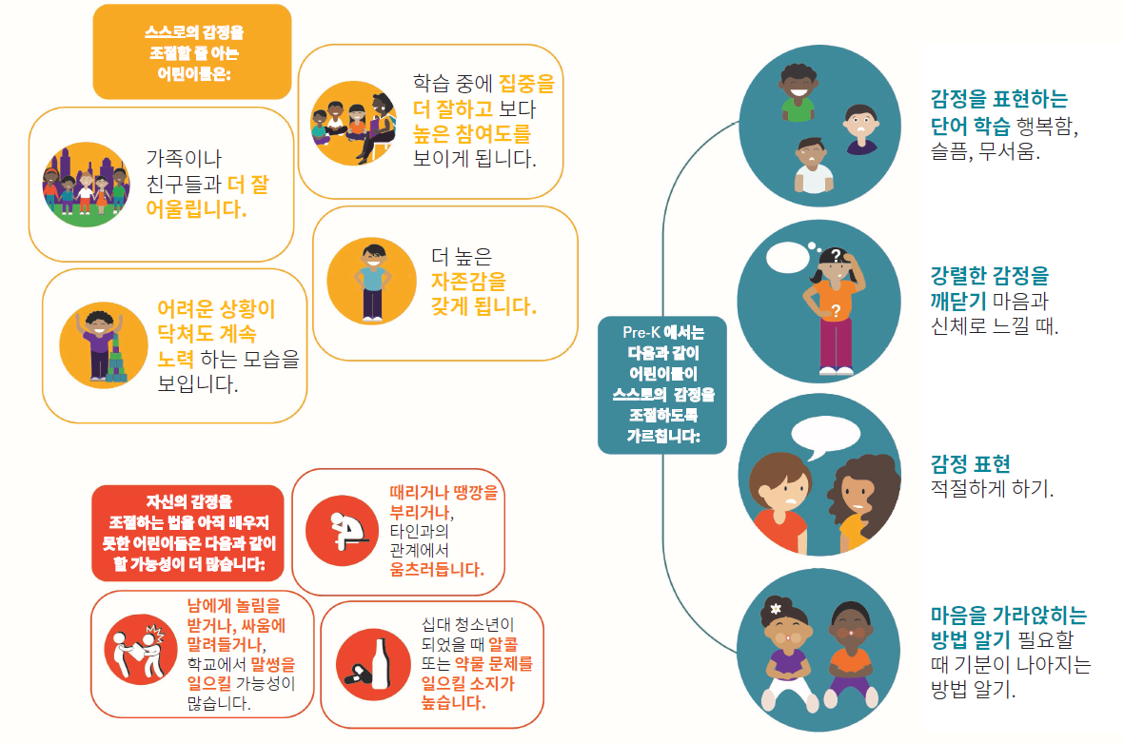
어린이들이 감정에 관해 배우는 것이 중요한 이유는 무엇입니까?
Notes:
Why is it important? (5 mins)
Briefly explain why it is important for children to learn about feelings.
You might say:
Young children at this age are just learning about feelings.
It is common for them to yell and shout when they are happy, or to hit and throw things when they are angry.
Repeat in child friendly language:
We all have strong feelings. Sometimes we feel happy, excited or proud. Sometimes we feel angry, sad or scared. We may feel frustrated sometimes when we’re learning to do something new.
There is very strong evidence that learning to deal with feelings matters, from studies that start when children are young and follow their progress all the way through high school and into adult life.
Option to walk through the infographic. Leave out any pieces you feel are inappropriate for children (e.g., the drugs and alcohol).
Say a little about how children learn about feelings in pre-K:
One of the important things you’re learning in pre-K is to notice when you have a strong feeling in your body. You can tell a grown-up or a friend how you’re feeling. "I’m so excited I want to jump up and down!" Or, "I’m frustrated. I need help.“
*You may also want to add in specific examples of how children at your site or in your classroom have been learning about feelings.
*HANDOUT AVAILABLE: Note that this slide can be found on pages 4 & 5 of your Teacher/Leader/Staff Handbook, and can be copied as a handout for families. It is also available to be printed online.

Slide 3
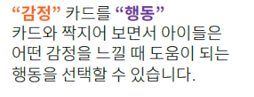
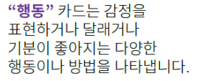
즐거운 감정놀이 카드!
Notes:
Introduce Handbook and Model using the Fun with Feelings Cards (5 mins)
Show families the Fun with Feelings cards and the Family Handbook they will receive with their deck.
Show the 2 types of cards:
Orange “I feel” cards show different feelings.
Purple “I can” cards show different actions you can take to express the feeling, calm down or feel better.
At the bottom of these cards there are little icons: a heart on the feelings cards and a lightbulb on the action cards. The icons match up together when you connect a feeling to an action.
Demonstrate how the icons match up at the bottom when you put the cards together.
The cards can also be used to build with!
If you haven’t already, demonstrate how the cards can be used to build by connecting the slits.
Show the three sets of instruction cards - Build, Play, Teach. Convey that the cards are designed for families and children to use however they choose.
Model how you might use one of the ideas from the Handbook with a child.
For example, read “Make a Face” on the Play page in the family handbook (p. 4), hold up an “I feel” card, say the feeling and make the face that goes with it.
Invite children to make the face too and describe what you see (You could say, “When you smile, your eyes sparkle.”)

Slide 4
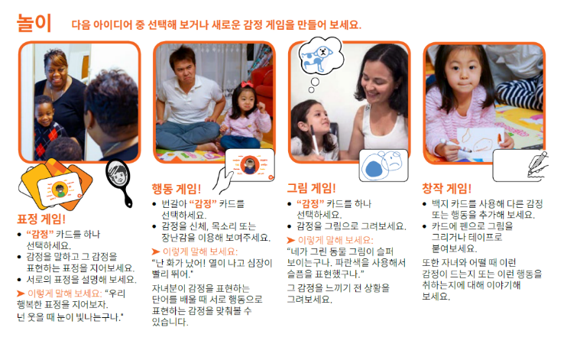
놀이를 해봅시다!
핸드북 4페이지입니다!
Notes:
Invite Families to Explore the Handbook and Play with the Cards (10-15 mins)
Choose one of the ideas from the Play page and suggest that families try that first. Hold up the Handbook and read aloud.
Encourage families to move ahead to the first Teach page or try another Play idea when they are ready.
Support families who are struggling to engage their children in meaningful interactions by modeling strategies that you’ve found to be useful.
If children’s antsy-ness levels allow, invite families to share about their favorite part of the activity or any ideas they had about other creative ways to use the cards at home or on-the-go.

Slide 5
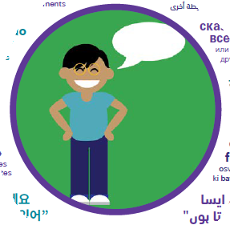
돌아보기
오늘 배운 것을 각자 생각해 봅시다...
자녀와 함께 연습해보고 싶은 사회 정서적 기술은 무엇입니까?
이 카드들을 가정이나 그 밖에 이동 중에 어떻게 사용할 계획입니까?
오늘 소감을 다른 참석자들과 공유하거나 오늘 내용에 관해 더욱 자세히 알기 위하여 자녀의 교사에게 질문하고 싶은 내용은 없으신가요.
Notes:
Self-Reflection (2 Mins)
*If time and children’s antsy-ness level allows…
Encourage families to think to themselves briefly about what we have talked about today and how it related to their child.
I invite you to take a moment to reflect: Which, if any, social emotional skills may you want to work on with your child? How might you imagine using the cards at home or on the go?
Give them a minute to think quietly.
After giving them a minute to think, remind them they can partner with their child’s teacher to learn more about Social Emotional Learning and how its done in their classroom.
“If you are interested, consider sharing reflections and questions with your child’s teachers to learn more about your child’s Social Emotional Learning.”

Slide 6
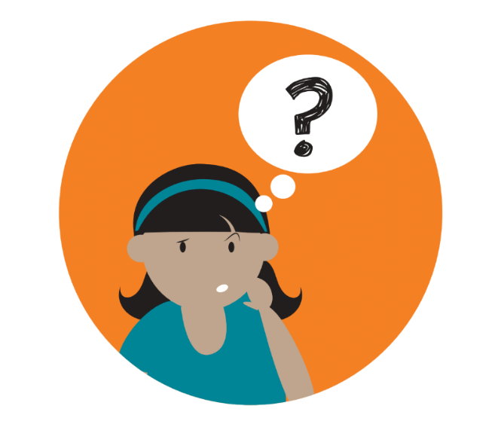
질문이 있으십니까?
Notes:
Ask Families to share any remaining questions.

Slide 7
감사합니다!
Notes:
•Thank families for attendance and participation.
•If possible, make yourself available for brief one-on-one interactions with families as they leave.

